Slide 1
Getting to know your employee-to-be
Géza Orgován

Slide 2
Me, in bullet-points:
Oldest descendant with 6 siblings
Science and math-focused studies
Technical manager degree
Excel-ninja and event-lightning prior work experiences
Junior developer studies in progress

Slide 3
In my spare time
I love sports: running, badminton, foosball, billiards, table tennis
Really into travelling, exploring the hidden gems in cities
Participating in team-building events

Slide 4
My current level of programming knowledge & experience
HTML &CSS
CLI
git
Typescript & javascript
Node.js
Backend-basics:
npm express
npm ejs

Slide 5

Task: wanderer game- Until the character is standing on a monster, it shouldn’t be able to move
A QUICK LOOK INTO MY WAY OF THINKING
Notes:
…so in other words: the monsters should trap the hero

Slide 6
Interconnecting functions

Slide 7
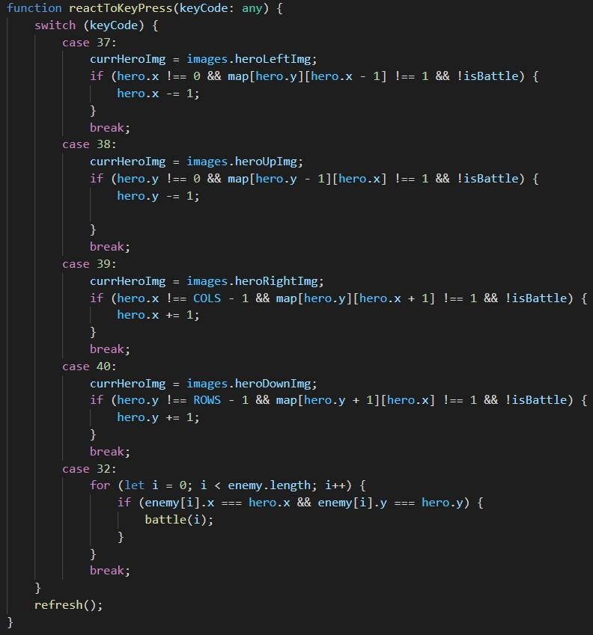
“React To Key Press” function

Slide 8
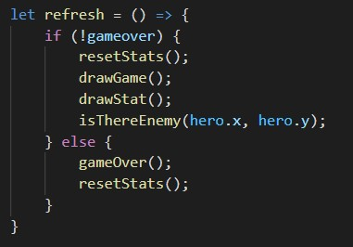
“Refresh” function

Slide 9
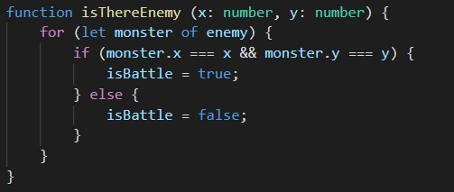
“Is there enemy” function

Slide 10
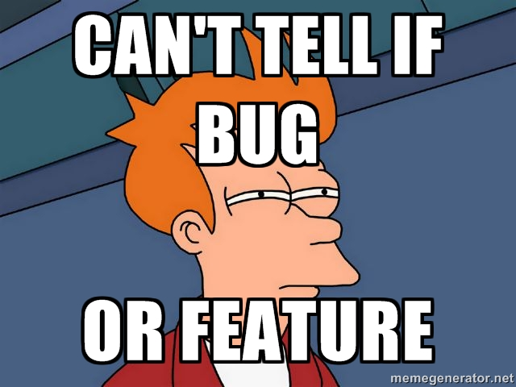
Works, but only sometimes…

Slide 11
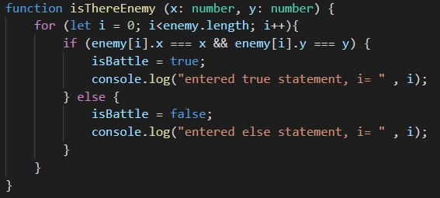
“Is there enemy” function
modified to be able to console log
And debug

Slide 12
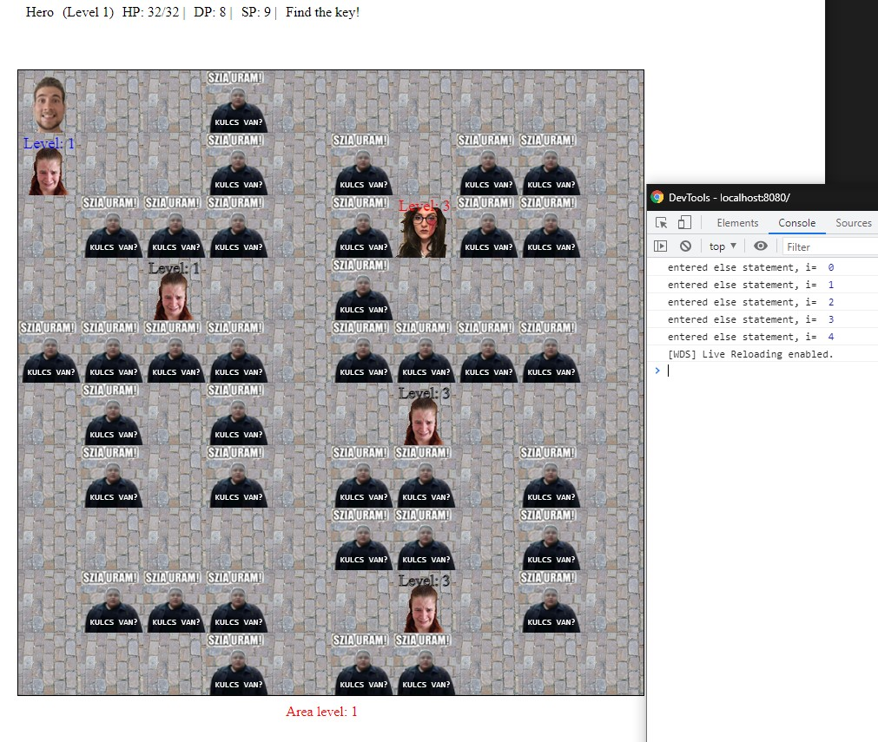
When the hero is on an empty space

Slide 13
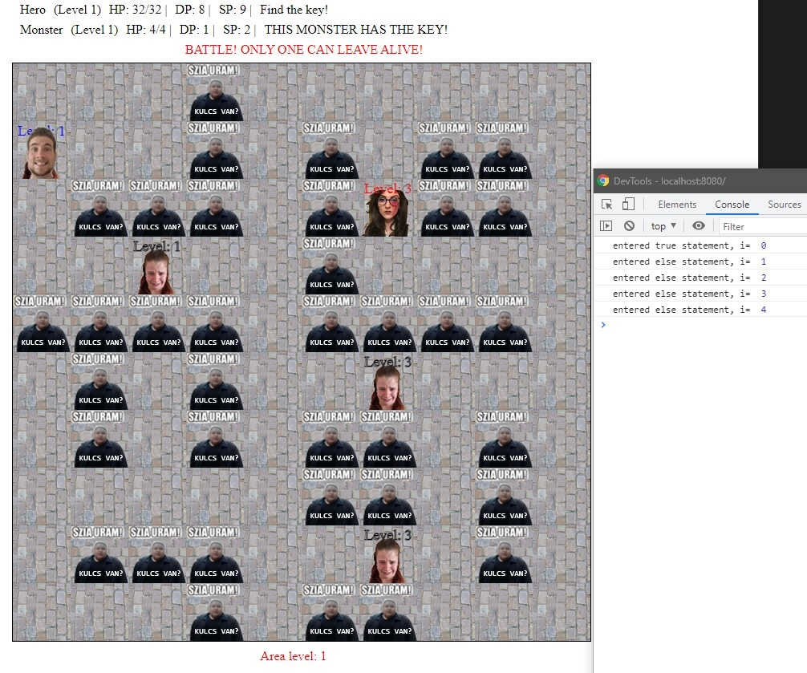
When the hero is on an enemy, that doesn’t trap the hero

Slide 14
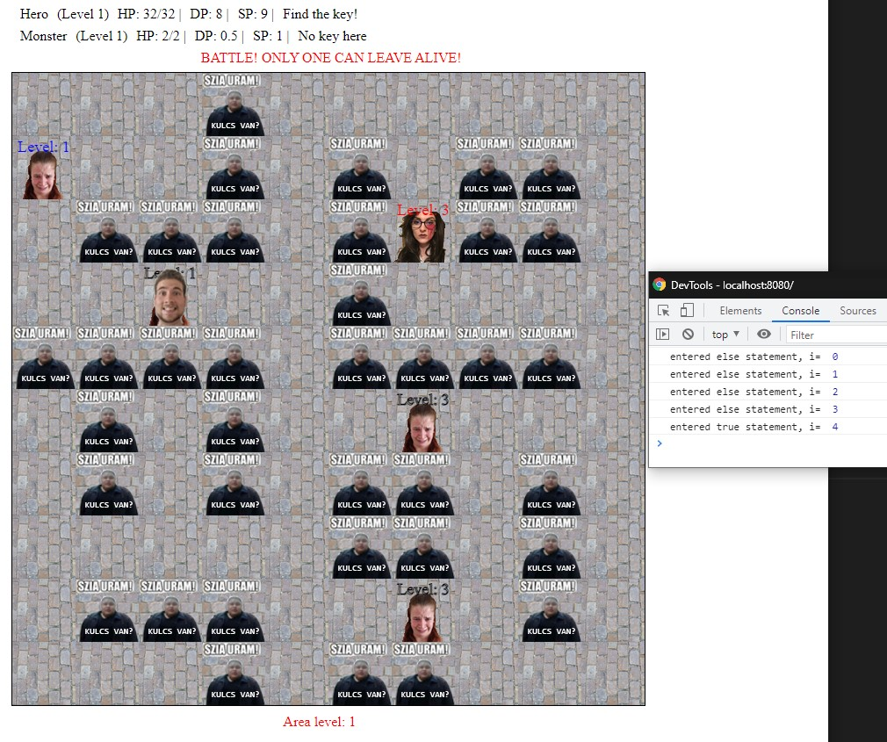
When the hero is on an enemy, that traps the hero

Slide 15
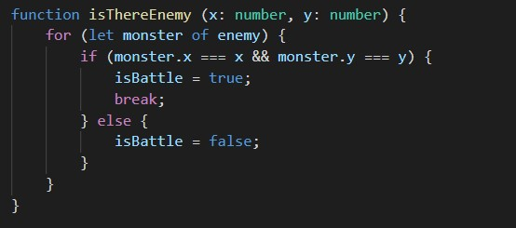
“Is there enemy” function
“Is there enemy” function with added break

Slide 16
My wishes for my future carrier
Keep up with the trends
Continuously improve my skills
Inspire my colleagues

Slide 17
Slide Tite
Thank you for the attention!

